Slide 1
Reproducibility Study
Group 3
Beladiya, Jay Sanjaykumar
Indala, Divya Sai Sukanya
Panula, Jennifer
Valaboju, Shiva Kumar Chary
Heart Failure Survival Analysis (KM, Cox, ML)

Slide 2
Background (Original Study)
Predict survival in heart failure patients
Methods: KM, Cox, ML models (SVM, decision tree, random forest, XGBoost, and LightGBM)
Dataset: 299 patients, 13 features
Goal: identify mortality predictors

Slide 3
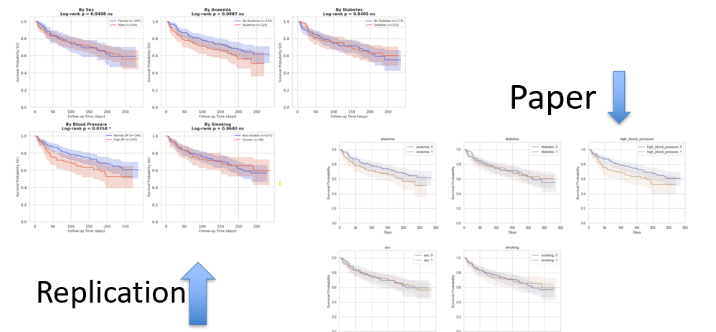
Kaplan-Meier (KM)
Q: How does survival change over time?
Same survival trends observed
Survival ↓ over time (matched paper)
Key factors: creatinine, EF, anemia, BP
Only minor numerical differences
Notes:
KM is about survival curves, not prediction. This suggests strong reproducibility for descriptive survival patterns.
The image represents the KM trends of the Binary Variables and the Paper’s results and Replication appear the same.

Slide 4
Cox Regression
Q: Which factors impact death risk?
Same key predictors identified
Age & creatinine ↑ risk
Ejection fraction ↓ risk (protective)
Non-significant: sex, smoking, diabetes
Notes:
Cox gives us interpretable relationships. We got the same significant variables. This tells us the underlying relationships are robust.

Slide 5
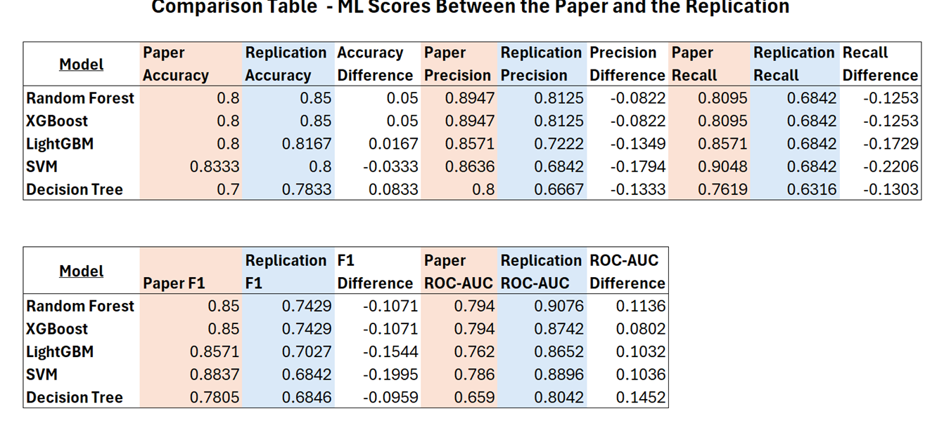
Machine Learning Models
Q: Can we accurately predict death?
Best models: Random Forest, XGBoost (same ranking)
Feature importance consistent (time, EF, creatinine, age)
Accuracy similar (~ within 0.08)
F1/Recall lower, ROC-AUC higher
Notes:
One key takeaway is that statistical models like KM and Cox were more stable, while machine learning models were more sensitive to implementation choices

Slide 6
What Influenced Replication Outcomes?
Notes:
Biggest issue: we accidentally kept ‘time’ in the prediction models. This is data leakage which inflates performance and may explain why our ROC-AUC was higher

Slide 7
Ethical Takaways
Reproducibility builds trust and contributes to the scientific knowledgebase
Small changes can result in different outcomes
Extra Important, especially in high-stakes environments like healthcare
Data leakage can mislead performance

Slide 8
Recommendations
Remove leakage variables explicitly
02
Use cross-validation (not single split)
03
Include uncertainty (multiple runs)
04
Use larger datasets, if obtainable
05
Report full hyperparameters + preprocessing
01

